Slide 1
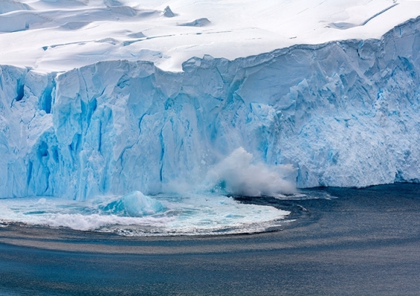
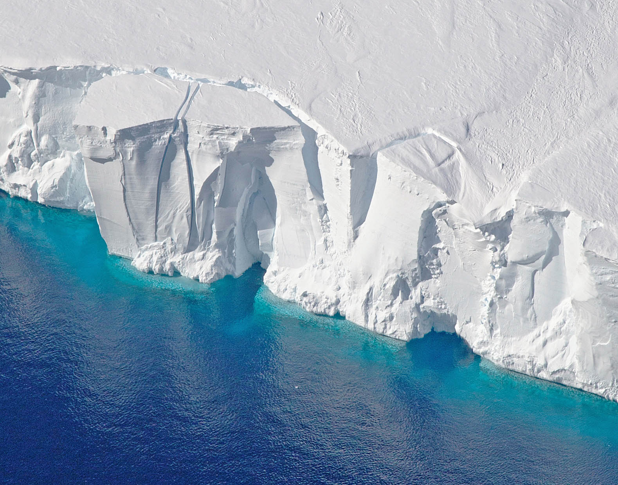
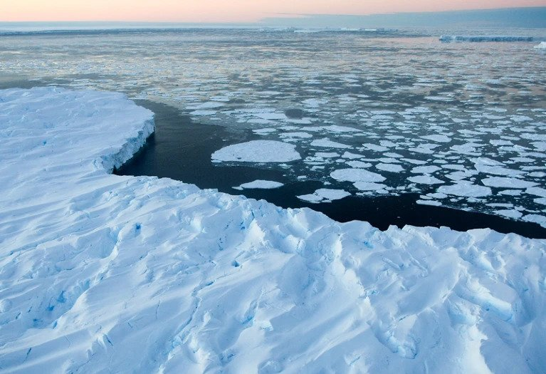
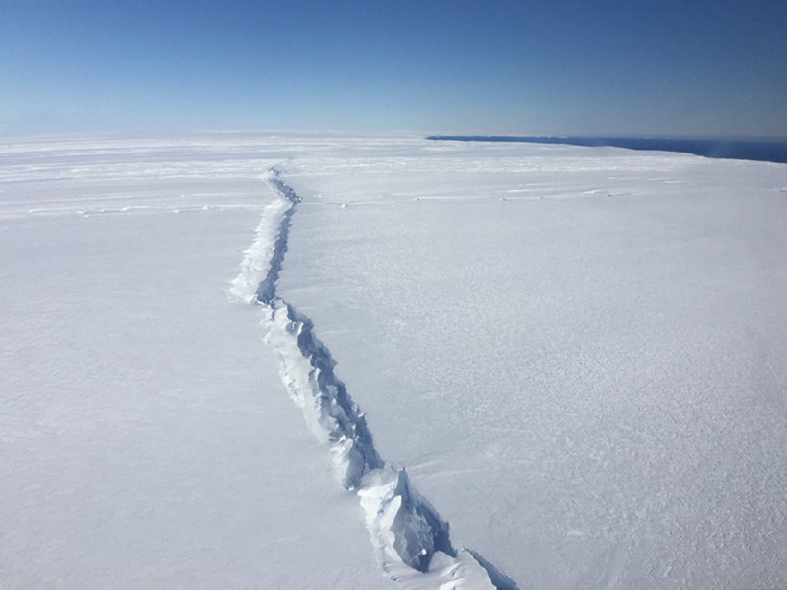
Multi-fidelity experimental design for ice-sheet models
Pierre Thodoroff

Slide 2
Agenda
ROI
Intro to ice sheet modelling
Intro multi-fidelity experimental design
Some code examples
Finally some issues with methods
Visualise quality intellectual capital
Engage worldwide methodologies with web-enabled technologies

Slide 3
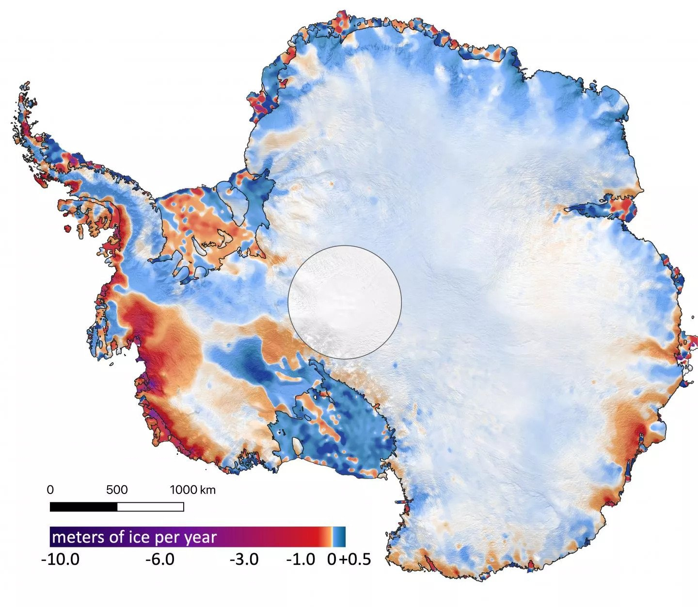
Sea-level contribution
Reflect sun
Melts in the water

Slide 4
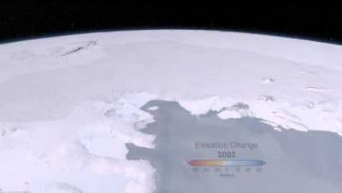
Notes:
This is the sea we are working on.

Slide 6
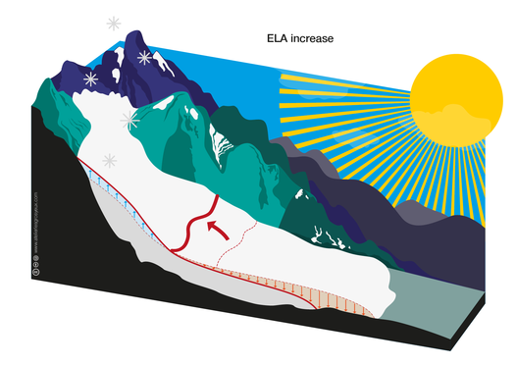
MASS BALANCE

Slide 7
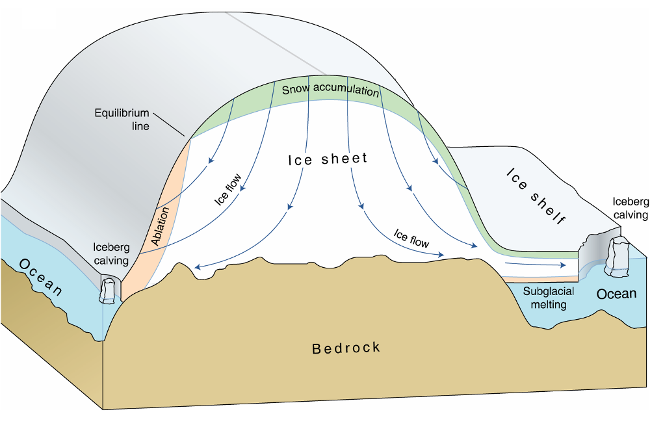
Ice-sheet model
Stokes equation
Based on snow accumula
and ablation

Slide 8
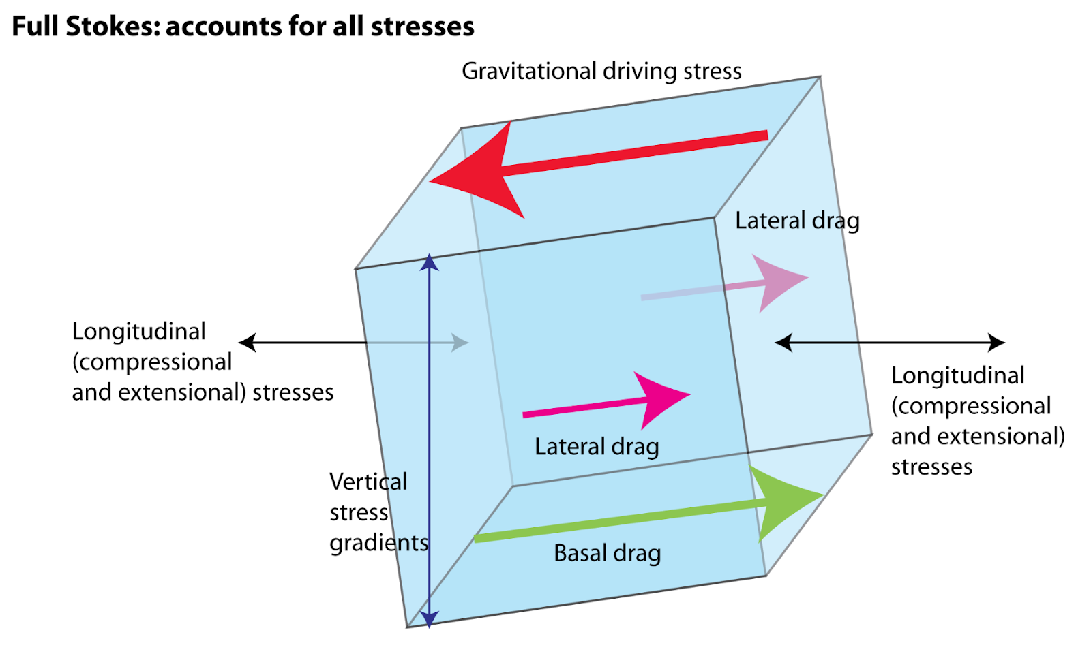

Slide 9
Add PDE formal definition + some math?

Slide 10
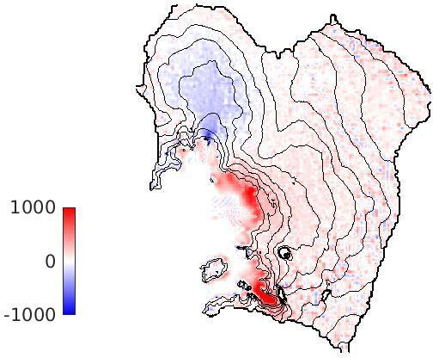
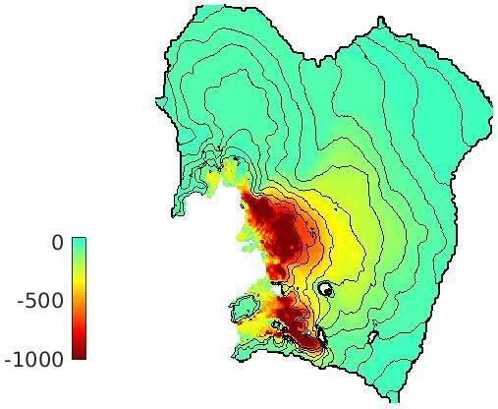
RESOLUTION DEPENDENCY
Left: modelled ice thickness change (in metres) over 100 years. Right: the difference in modelled ice thickness between a 10 km and a 3 km simulation.

Slide 11
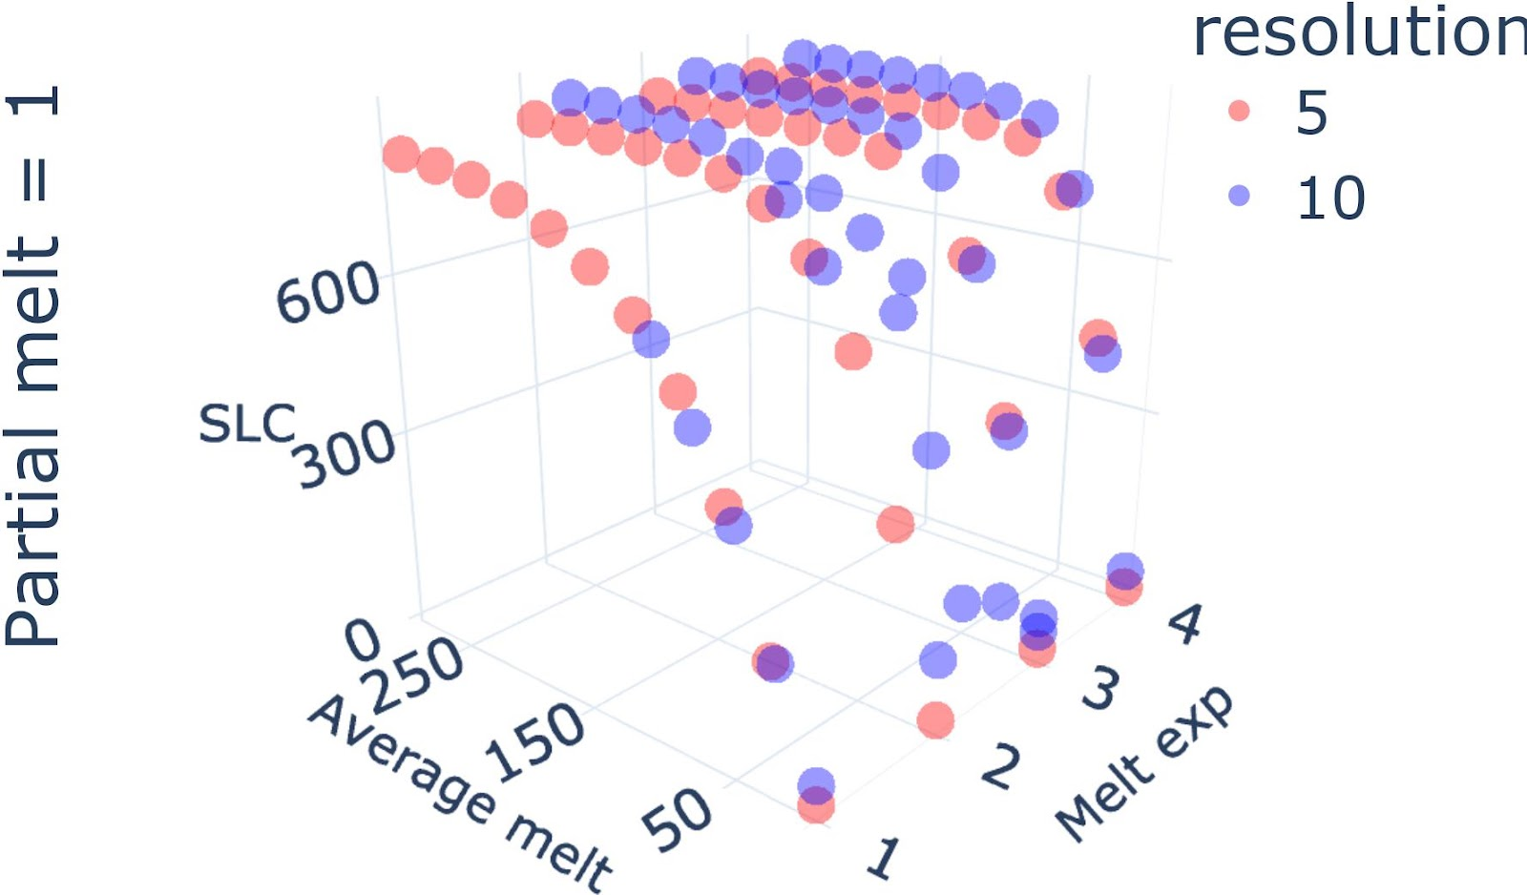
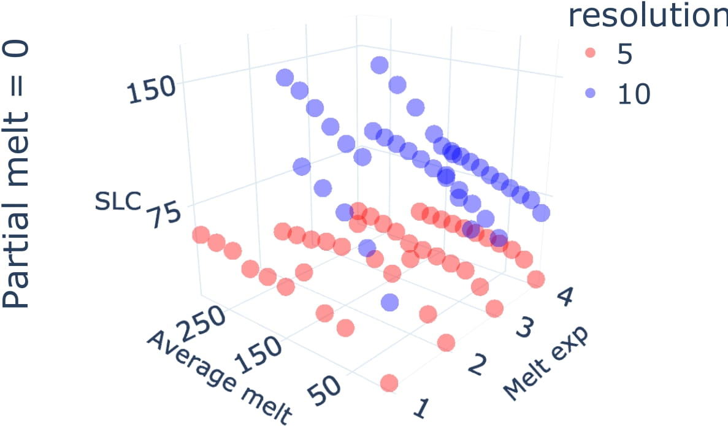
Intutive explanation with some visual

Slide 12
MFED for numerical solvers
Greedy approximation is good: utility/cost

Slide 13
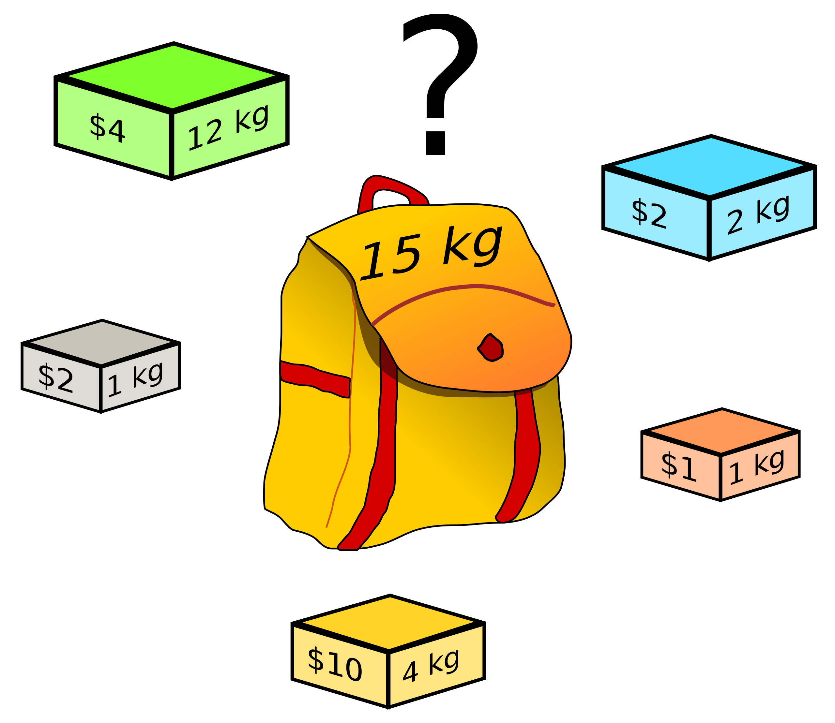
Knapsack problem
Detail the knapsack problem
NP-hard

Slide 14
GREEDY APPROXIMATION
Greedy approximation is good: utility/cost

Slide 15
Space filling versus model based ED

Slide 16
Multi-fidelity

Slide 17
GP model?

Slide 18
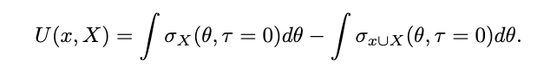
Utility

Slide 19
How to assign value to a resolution ?
Add in the slide: when sampling. relying on a model to extrapolate.
Question how far can you extrapolate. Can extrapolate along parameter axis.
But what about the computational axis? If you use space-filling how do you compare runs at different resolutions? need to build a model.
Lets build a model both for parameter and computational axis.
Equivalence in prediction in either direction if lengthscale is the same.
Whole point is learning lengthscale in this case.
But can now decide between parameter or compuational focus, quite cool
Could make example of surface being similarly impacted

Slide 20
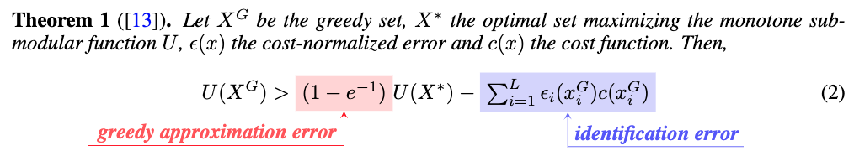
Some theoretical results

Slide 24
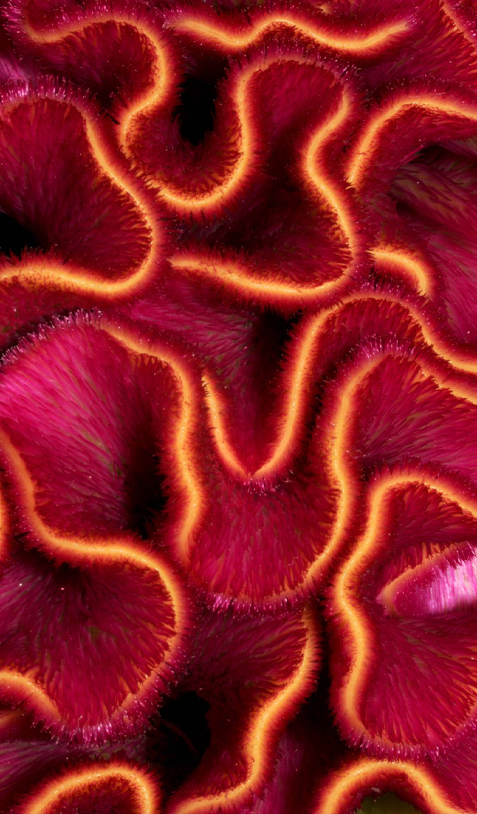
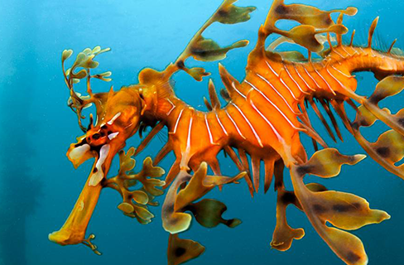
INTRODUCTION
At Contoso, we empower organisations to foster collaborative thinking to further drive workplace innovation. By closing the loop and leveraging agile frameworks, we help business grow organically and foster a consumer-first mindset.

Slide 25
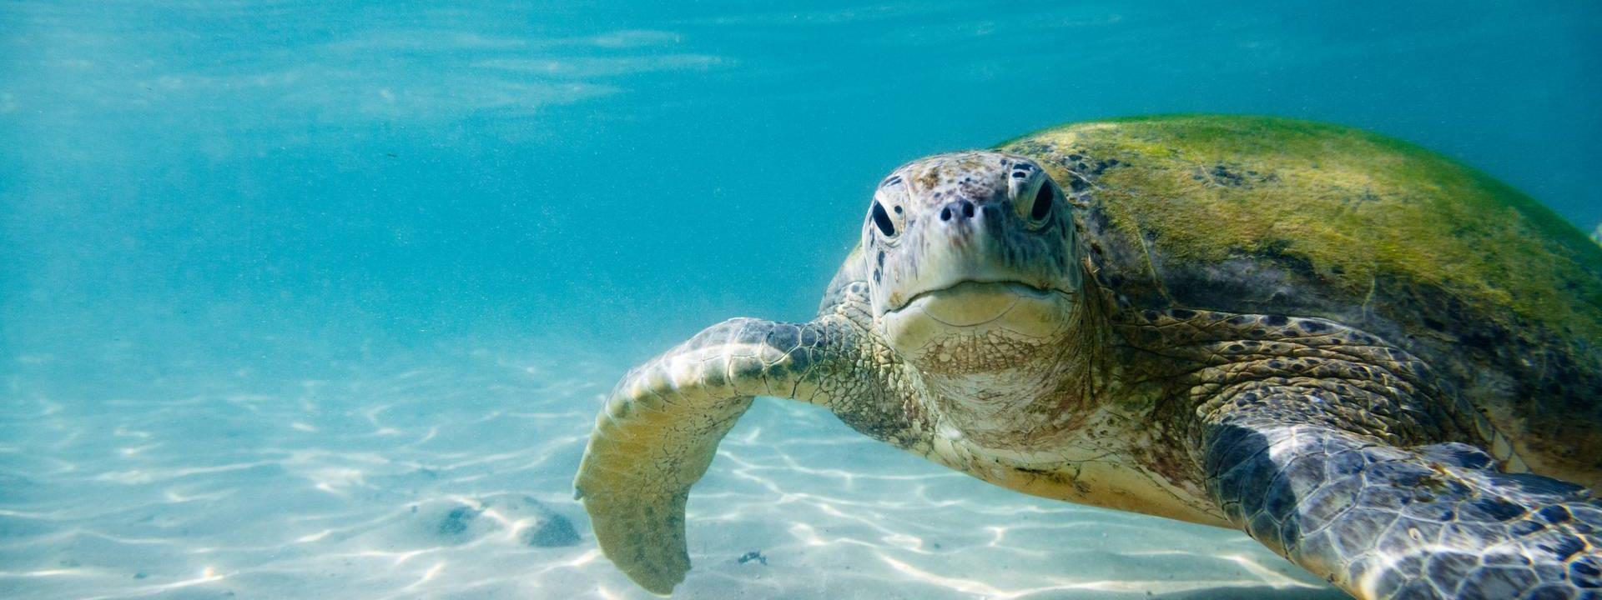
PRIMARY GROWTH
Areas of focus

Slide 26
QUARTERLY PERFORMANCE

Slide 27
Areas of growth
 | B2B | SUPPLY CHAIN | ROI | E-COMMERCE
Q1 | 4.5 | 2.3 | 1.7 | 5.0
Q2 | 3.2 | 5.1 | 4.4 | 3.0
Q3 | 2.1 | 1.7 | 2.5 | 2.8
Q4 | 4.5 | 2.2 | 1.7 | 7.0

Slide 28

Business opportunities are like buses. There's always another one coming.
RICHARD BRANSON

Slide 29




OUR TEAM
TAKUMA HAYASHI
MIRJAM NILSSON
President
Chief Executive Officer
FLORA BERGGREN
RAJESH SANTOSHI
Chief Operations Officer
VP Marketing

Slide 30
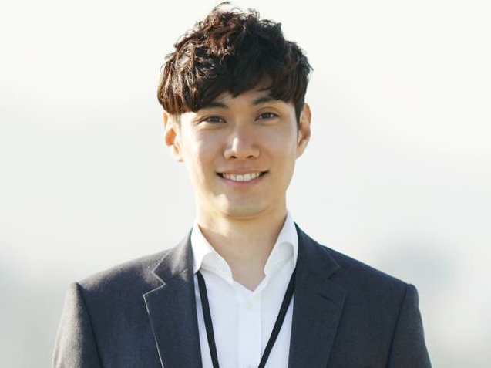
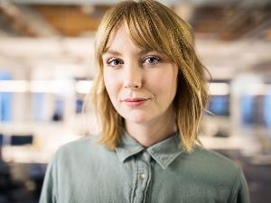

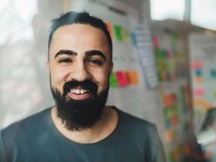
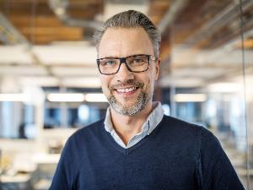



OUR TEAM
TAKUMA HAYASHI
MIRJAM NILSSON
FLORA BERGGREN
RAJESH SANTOSHI
President
Chief Executive Officer
Chief Operations Officer
VP Marketing
GRAHAM BARNES
ROWAN MURPHY
ELIZABETH MOORE
ROBIN KLINE
VP Product
SEO Strategist
Product Designer
Content developer

Slide 31
TIMELINE
Synergise scalable e-commerce
Coordinate e-business applications
Deploy strategic networks with compelling e-business needs
SEP 20XX
JAN 20XX
MAY 20XX
NOV 20XX
MAR 20XX
Disseminate standardised metrics
Foster holistically superior methodologies

Slide 33
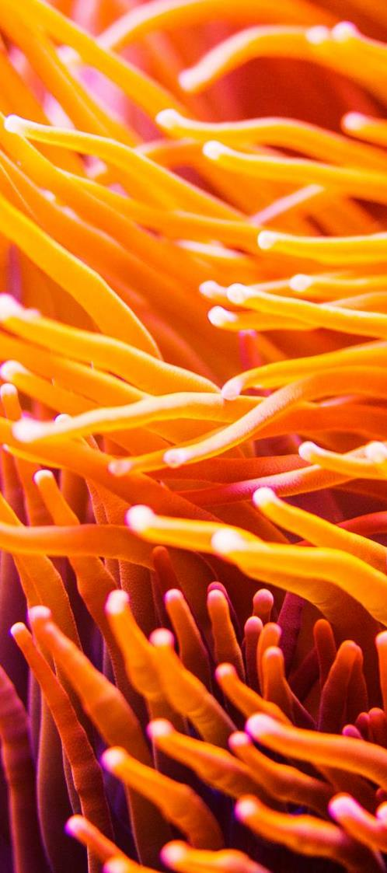
AREAS OF FOCUS
B2B MARKET SCENARIOS
CLOUD BASED OPPORTUNITIES
Develop winning strategies to keep ahead of the competition
Capitalize on low hanging fruit to identify a ballpark value
Visualise customer directed convergence
Iterative approaches to corporate strategy
Establish a management framework from the inside

Slide 35
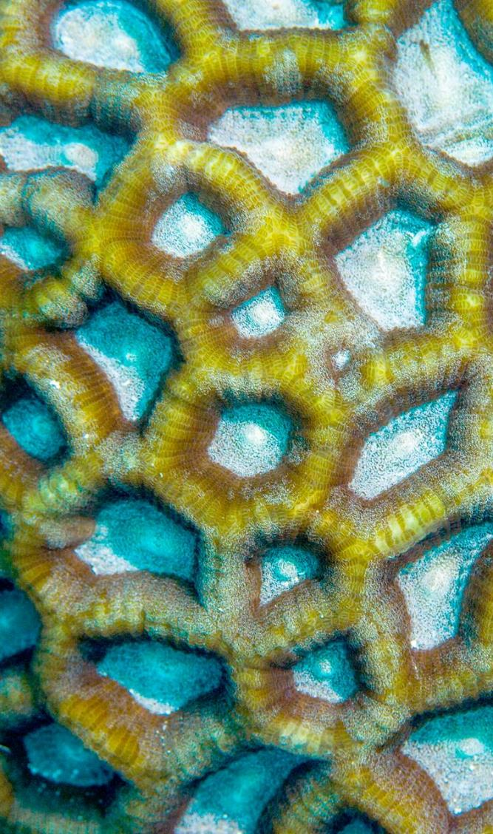
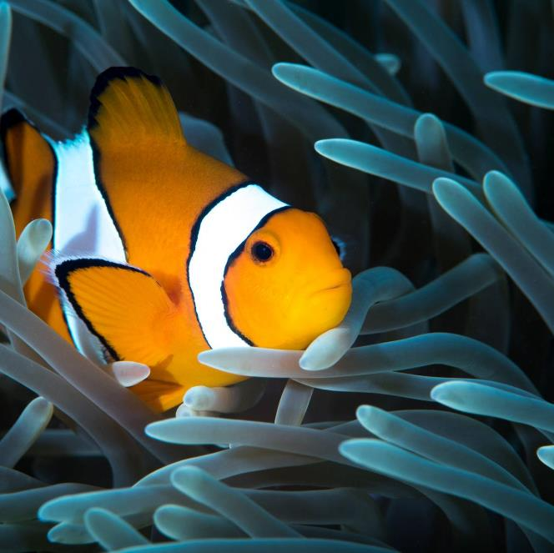
SUMMARY
At Contoso, we believe in giving 110%. By using our next-generation data architecture, we help organisations virtually manage agile workflows. We thrive because of our market knowledge and great team behind our product. As our CEO says, "Efficiencies will come from proactively transforming how we do business."

Slide 36
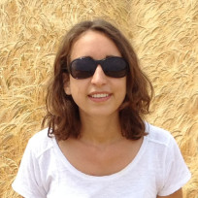
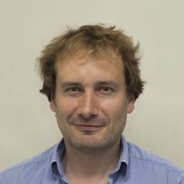
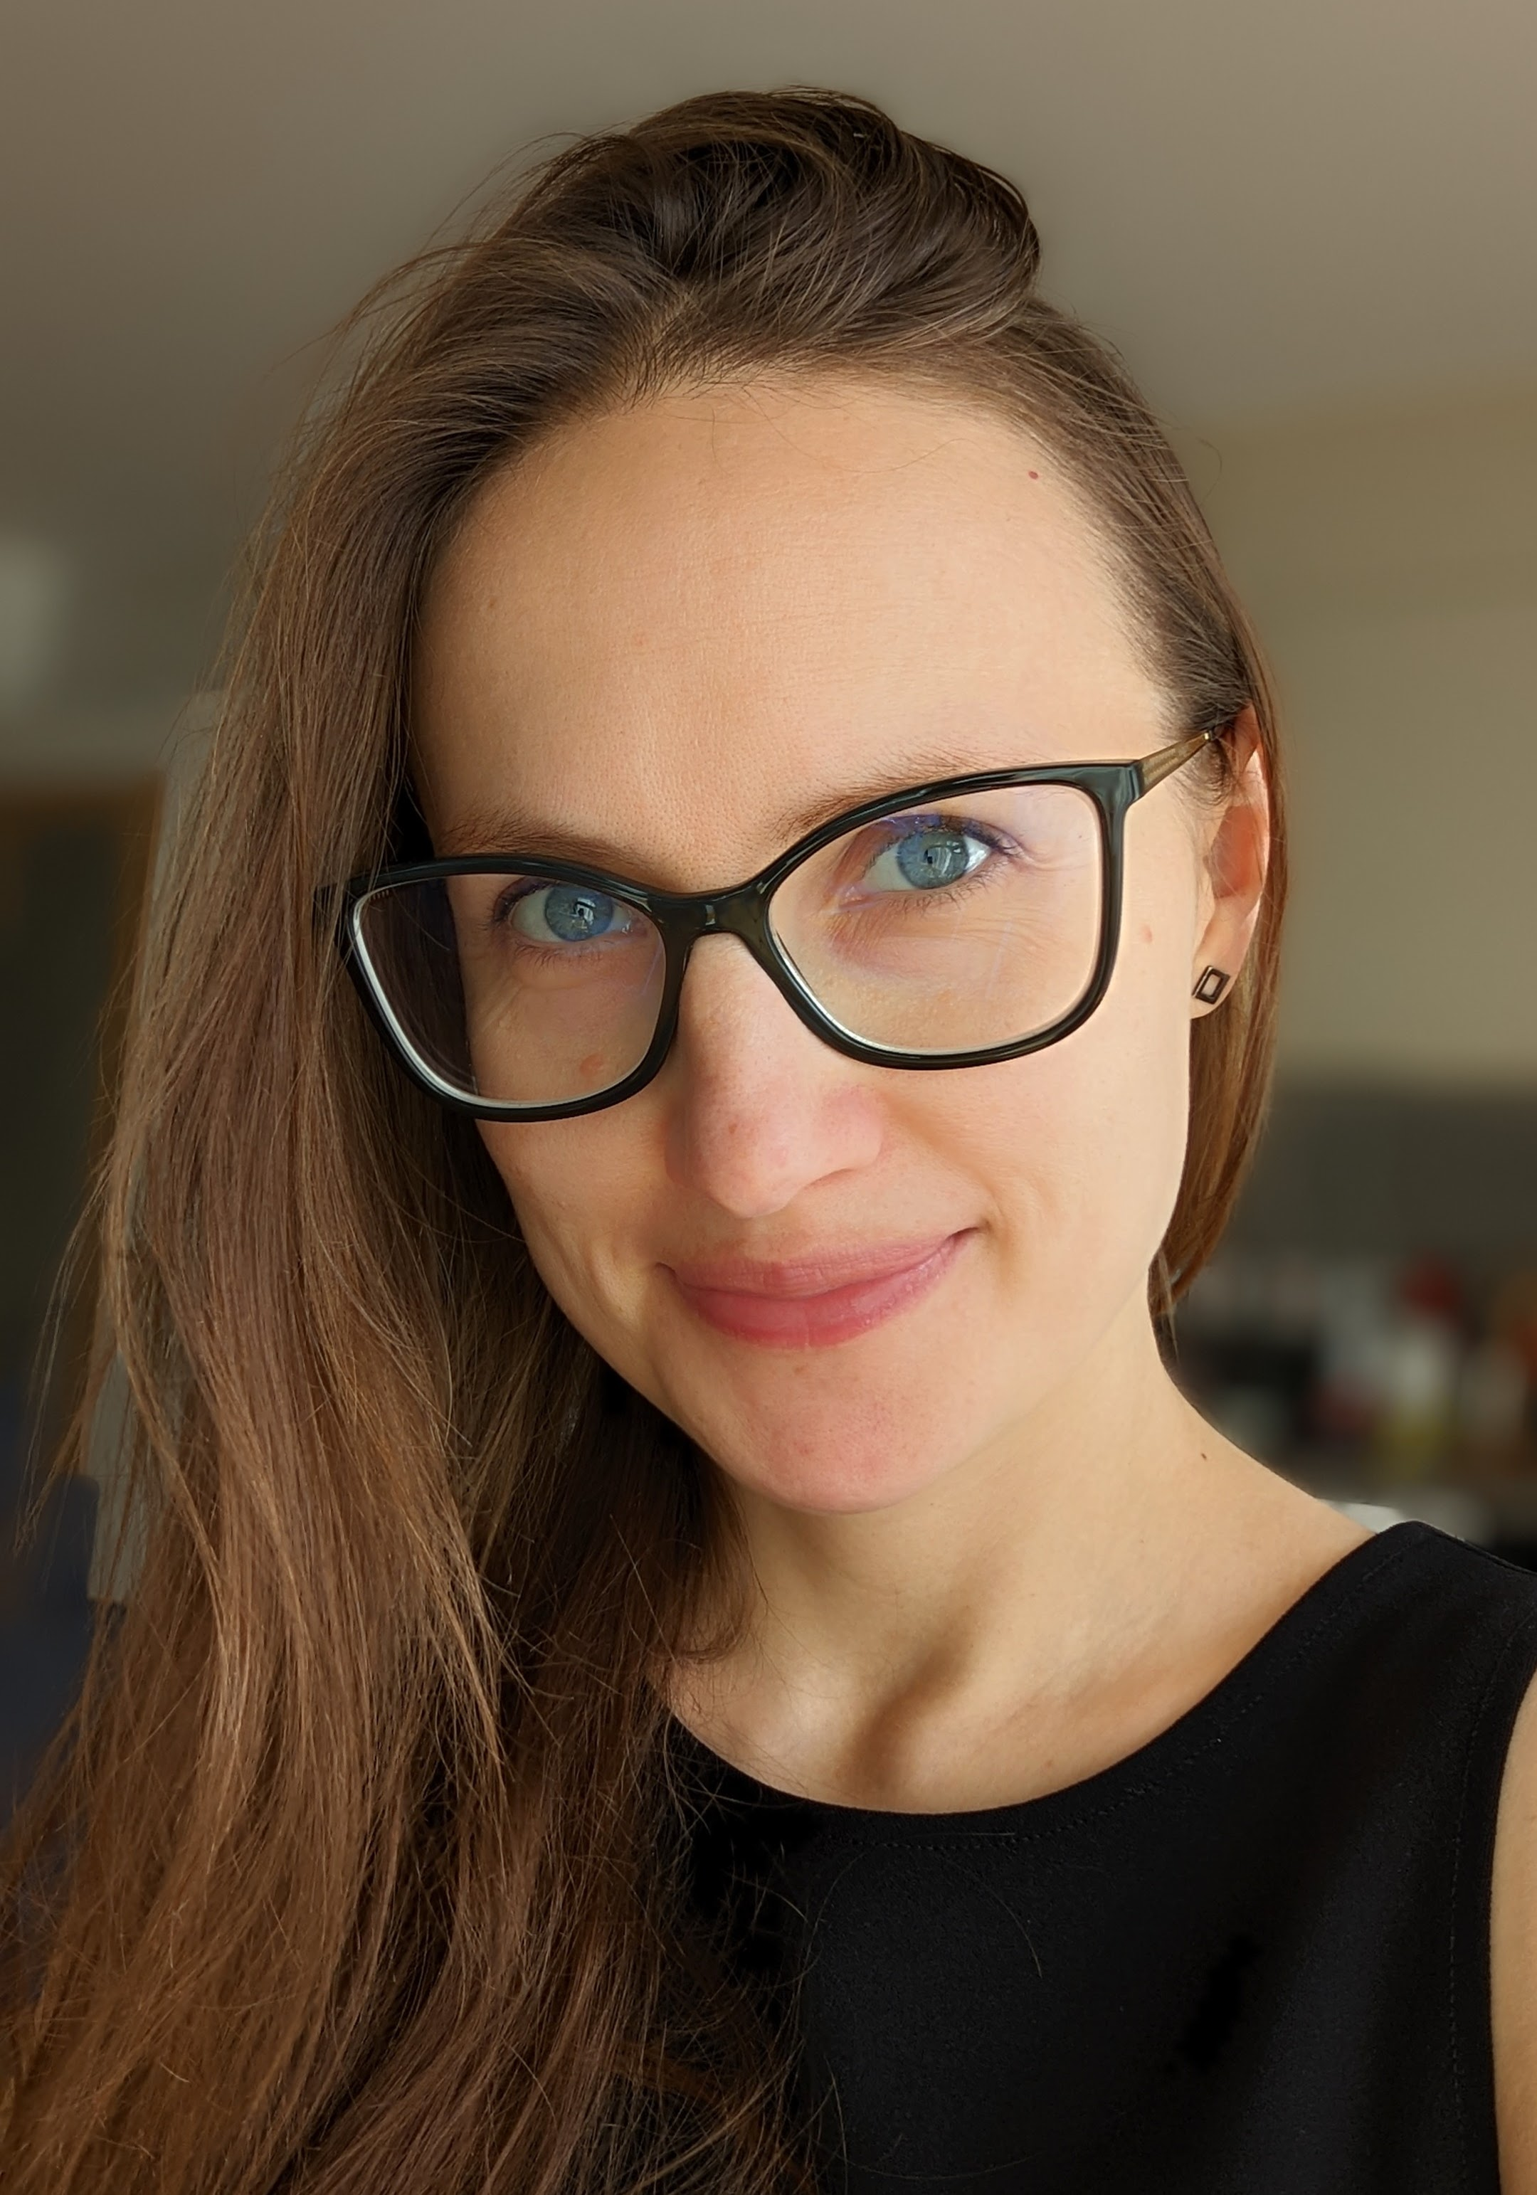
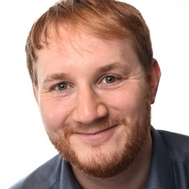
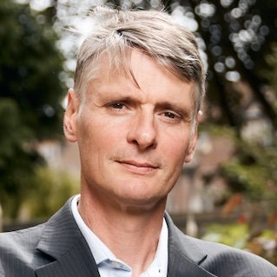
Collaborators
Rosie Williams
Robert Arthern
Ieva Kazlauskaite
Marcus Kaiser
Neil Lawrence
British Antarctic Survey
Department of Engineering at the University of Cambridge
British Antarctic Survey
Computer lab at the University of Cambridge
Computer Lab at the University of Cambridge

Slide 37
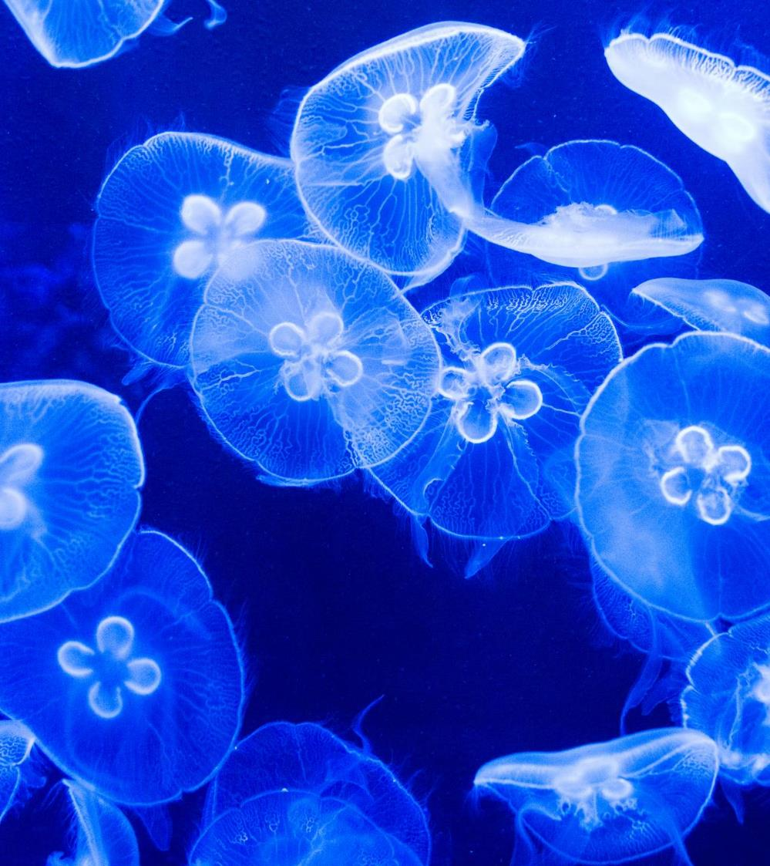
THANK YOU
Pierre Thodoroff

